Slide 1


Slide 2
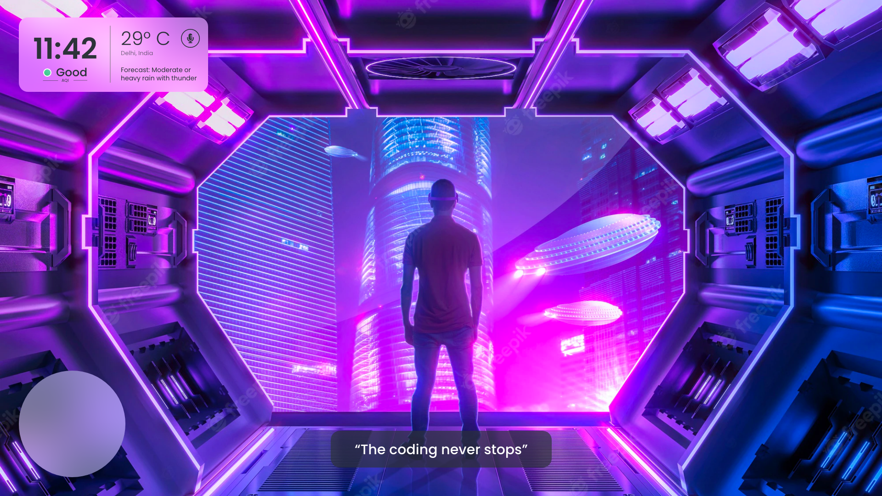

Slide 3


The Problem
Abuse - unhealthy environment
Rogue bots and AI - Identity theft, cyber crimes, etc.
Metaverse can be addictive.
Accessibility for disabled people

Slide 4
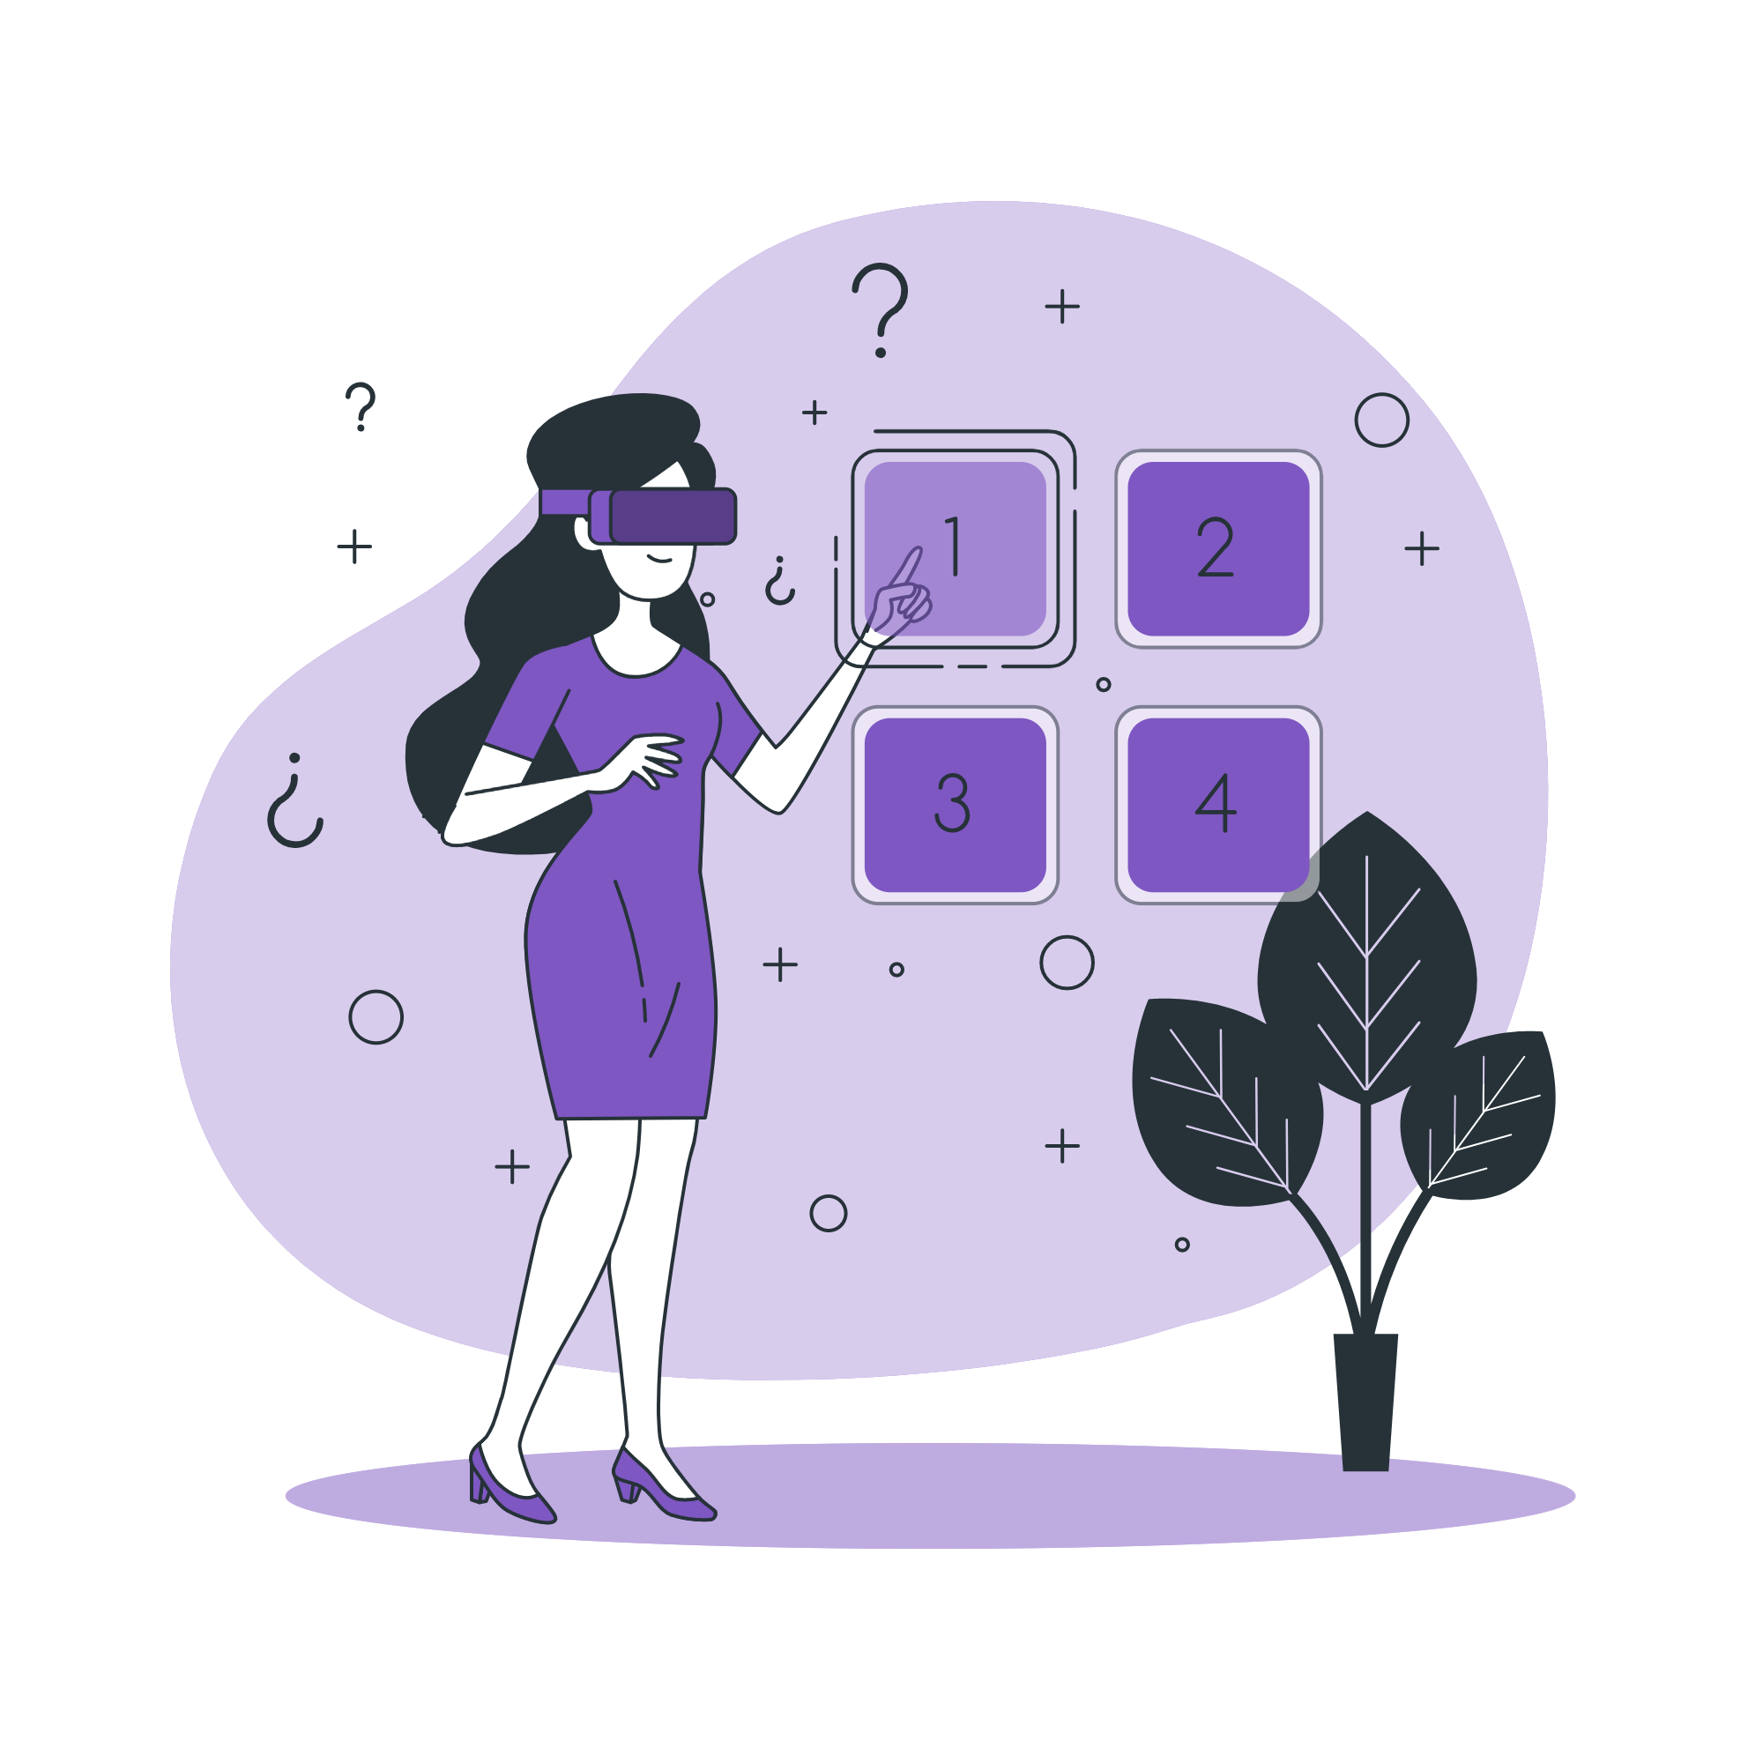
The Solution
Abusive language filtering
A rather creative human verification
Regular warnings and HUD - addiction
Captions for disabled people

Slide 5
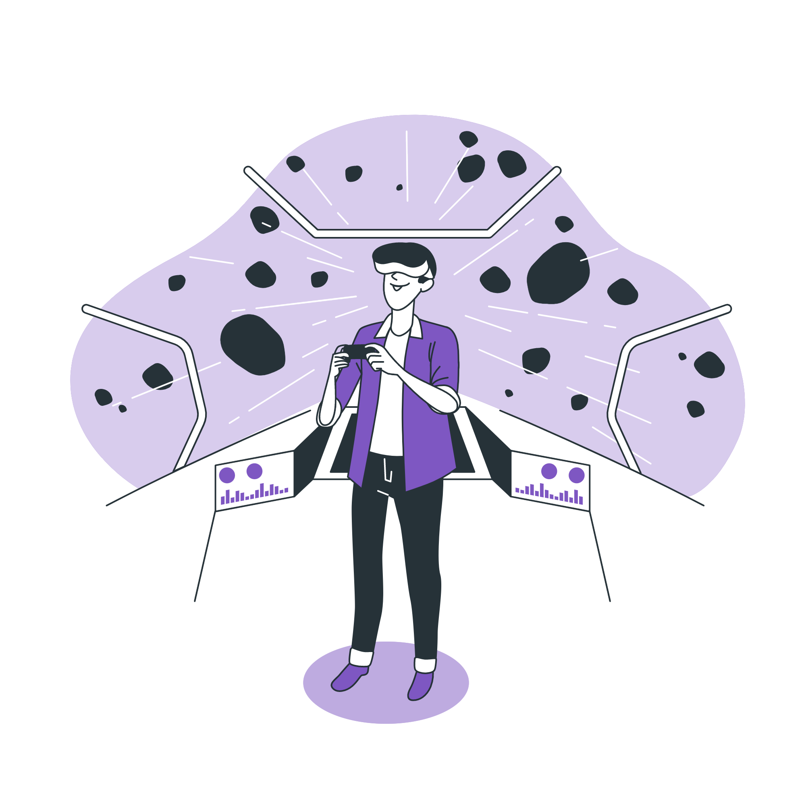
Future Plans
Broadcasting after abuse filter
Multiplayer avatar visibility
Decentralised marketplace for assets
Adding features specific to MetaVerse

Slide 6


Technologies

Slide 7
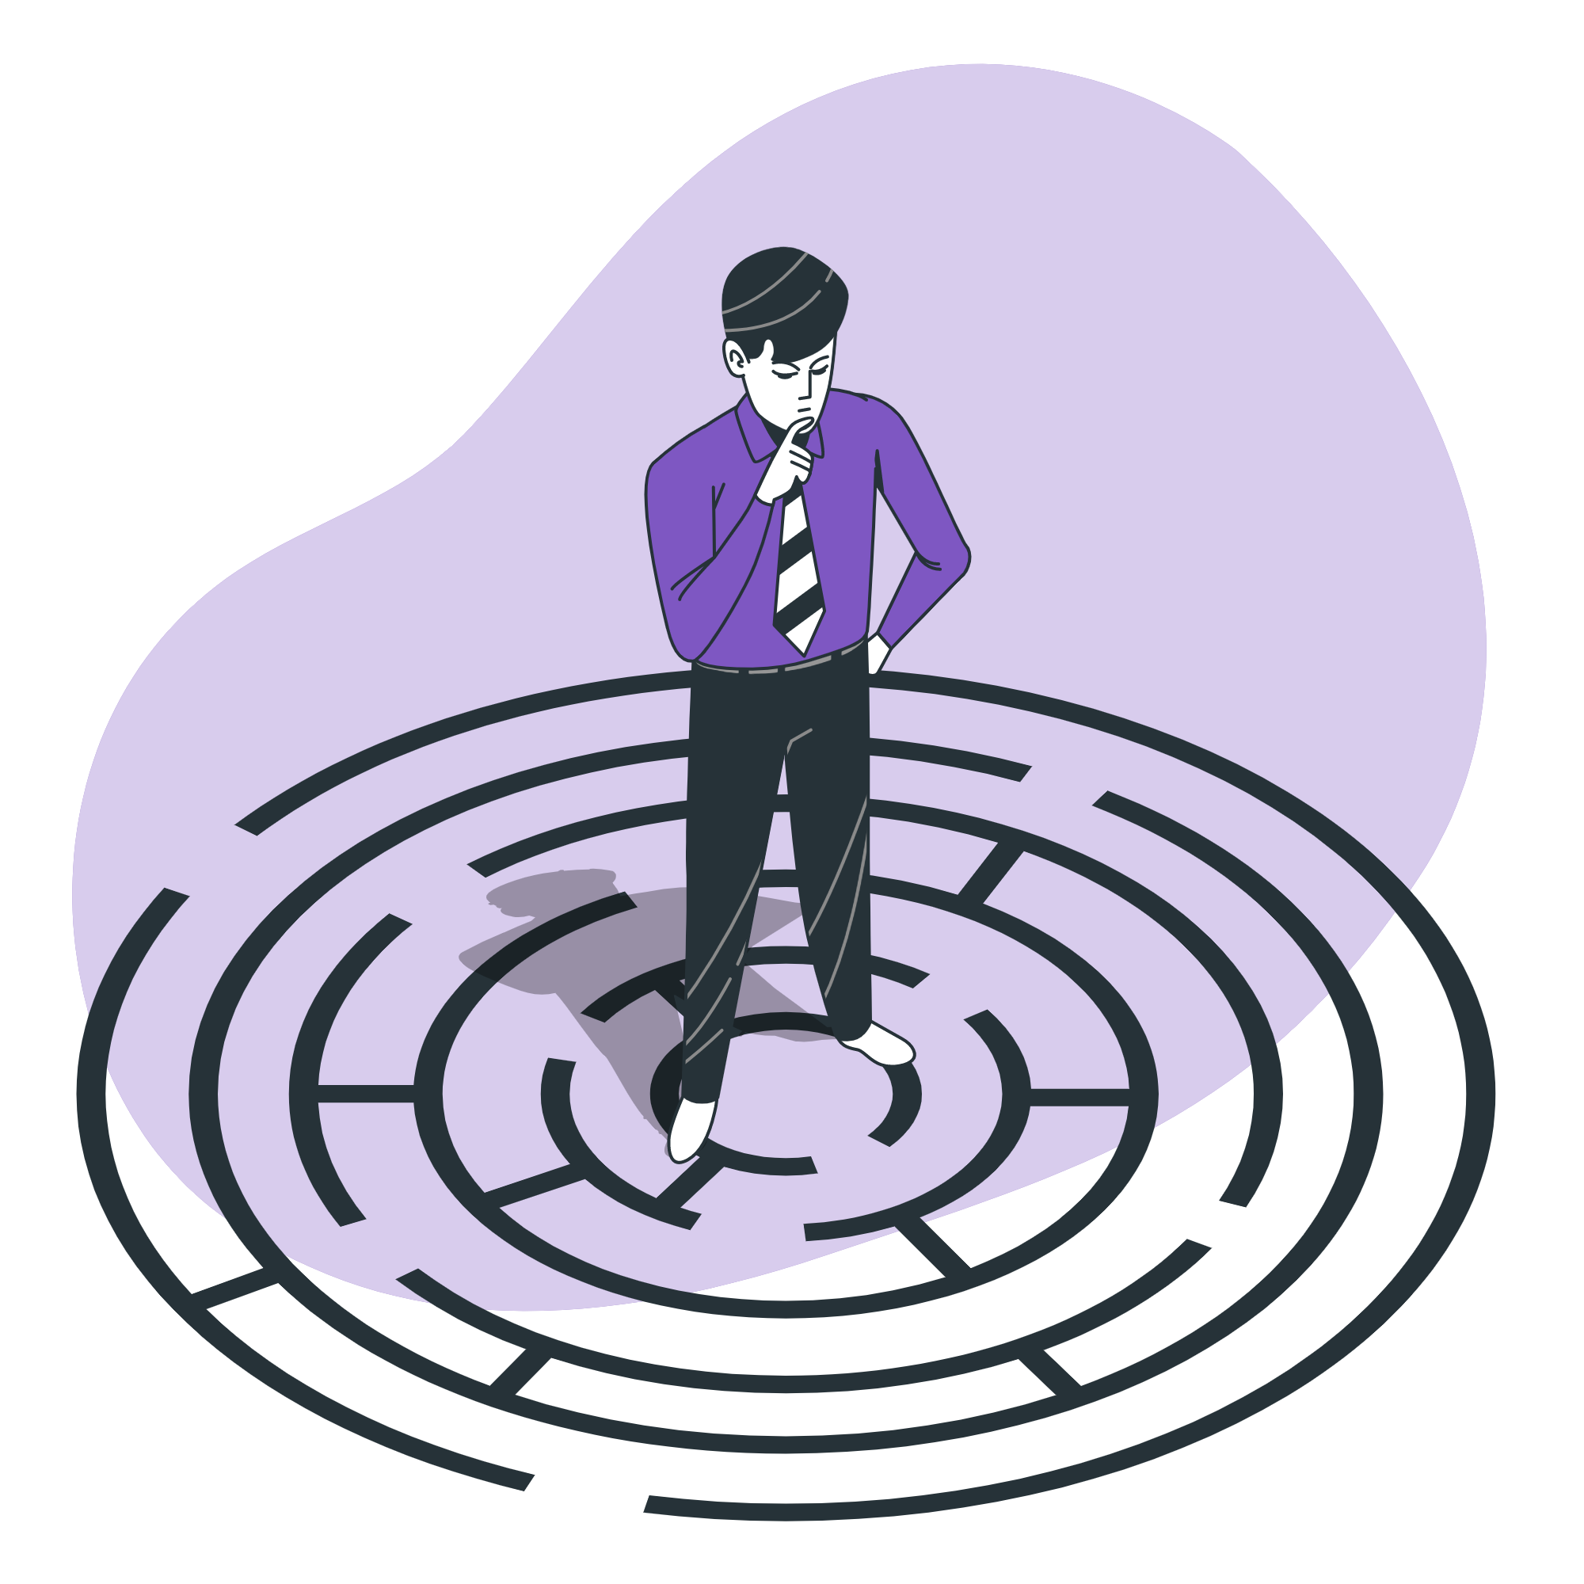
Challenges we faced
The prompt itself was a test of mettle - Our own Virtual world
Making a good looking and easily usable HUD - Transparent objects
Verifying humans based on emotions - Audio & Video overlap
Making a calling system and integrating it with the MetaWorld - Multi-person system connecting with WEBRTC.

Slide 8
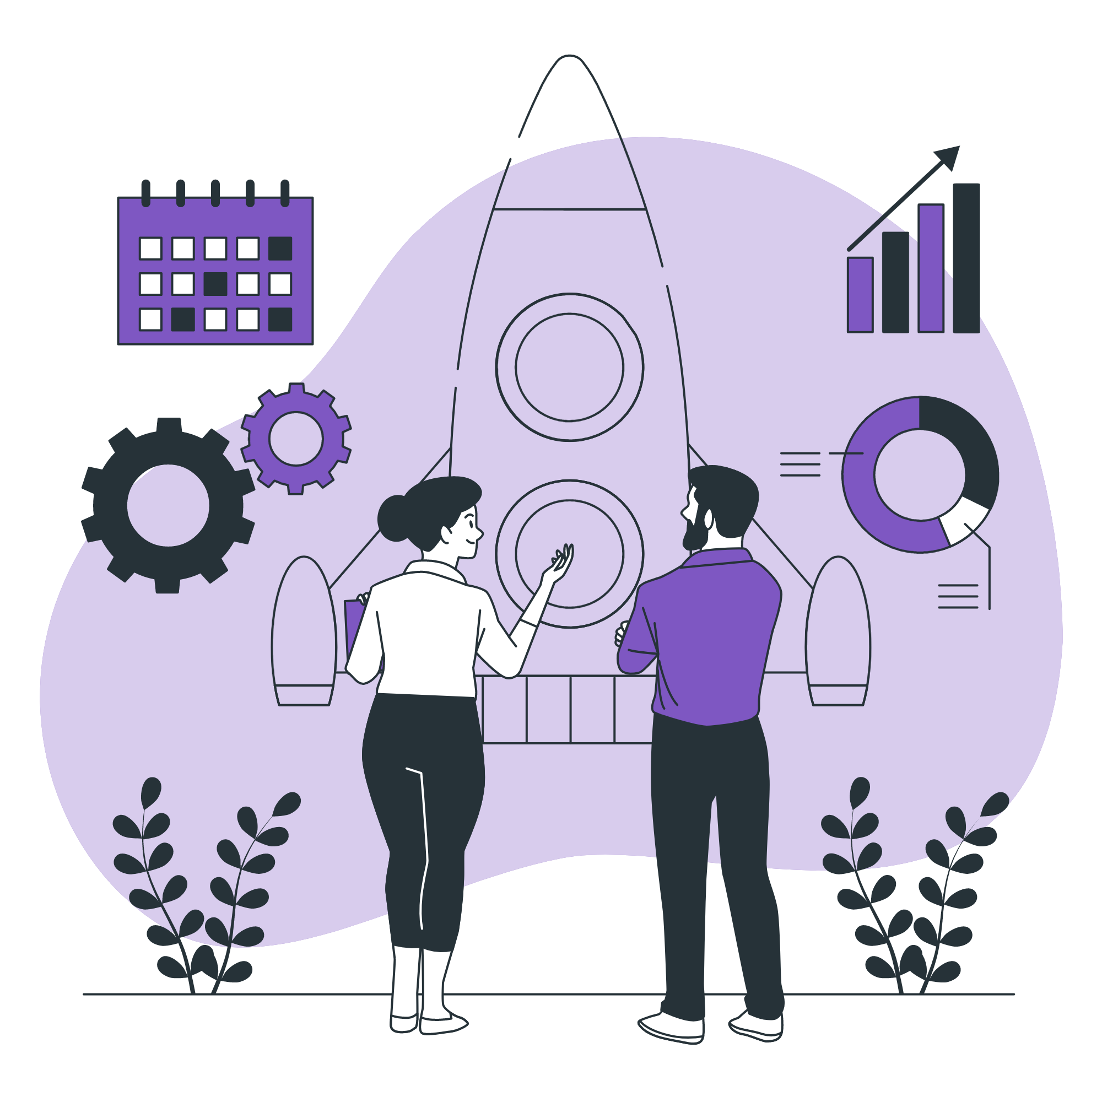
Business Model
THE TRIDENT:
Hardware distribution
Commercial software distribution
End-user software distribution

Slide 9
Thank you

